Slide 1
2022 Fall Sports Meeting
Flagstaff High School’s 100th Year

Slide 2
Introductions:
Libby Miller, Principal
Trish Eberlein, Asst. Principal
Matthew Barquin, Asst. Principal
Jeannine Brandel, Athletic Director
Donte’ Delia, Athletic Trainer
Trina Painter, Cross Country
Sean Manning, Football
Joth Jacobson, Golf
Rachel Perugini, Swimming
Beth Haglin, Volleyball
Rick McEnaney, Marching Band

Slide 3
Jeannine Brandel, Athletic Director
Flagstaff High School
400 West Elm
Flagstaff AZ 86001
Office Phone:
(928) 773-8105
Cell Phone:
(928) 607-4250
Email:
jbrandel@fusd1.org

Slide 4
Donte’ Delia, Athletic Trainer
Flagstaff High School
400 West Elm
Flagstaff AZ 86001
Office Phone:
(928) 773-8140
Cell Phone:
(623) 824-9680
Email:
ddelia@fusd1.org

Slide 5
ATHLETIC TRAINER
CONCUSSION PROTOCOL
Return to Play
Minimum 7 day progression back to play requirement
Twenty-four hours asymptomatic will begin the progression
Progression will be done with ATC/L until fully cleared
If symptoms return during progression student/athlete will start progression over
Return to Learn
Limited screen time
Standard adjustments will be in place 7 school days after diagnosis
If additional adjustments need to be made, parent may request meeting with teachers, counselors and ATC/L

Slide 6
For more information on concussion protocol and treatment, please go to the Athletic Training page on the FHS website.

Slide 7
ENVIRONMENTAL CONDITIONS
Heat Related Illness:
Heat Cramps
Minor Concern -- need to drink fluids
Heat Exhaustion
Moderate Concern -- Athletic Trainer
Heat Stroke
911
Heat Acclimatization
Progression
Cold Related Illness:
Frostnip
Most Common, easy to resolve
Frostbite
Possible Hospital visit if not treated
Hypothermia
911

Slide 8
OPIOID EDUCATION
Opioid Use is a serious issue that we believe requires all of us to act together. The State of Arizona along with the Arizona Interscholastic Association requires education be presented to our students each year. The AIA put forth a new course through the AIA Academy entitled Opioid Education. All students must complete this prior to being eligible for participation. This like Brainbook will be once in a student’s high school career.
A good reminder:
If you as a parent or teammate are concerned about a friend or teammate who may be using/abusing opioids; do not be afraid to reach out to a coach, a teacher, a counselor, an Athletic Trainer, or the Athletic Director to share your concerns.

Slide 9
CLEARANCE PROCESS
Students will need to complete the following:
Physical Examination ~ Dated on or after March 1, 2022
Physical Evaluation ~ Signed by the physician
Brainbook ~ Education done once in a student’s high school career
Opioid Education Course ~ Education done once in a student’s high school career
Online Registration through FinalForms ~ Filled out by parents

Slide 10
REGISTRATION PROCESS:
Parents fill out/sign on FinalForms Students sign on FinalForms Physical AIA Courses Make sure you use a password you can remember so you can go back in to review or update.

Slide 11
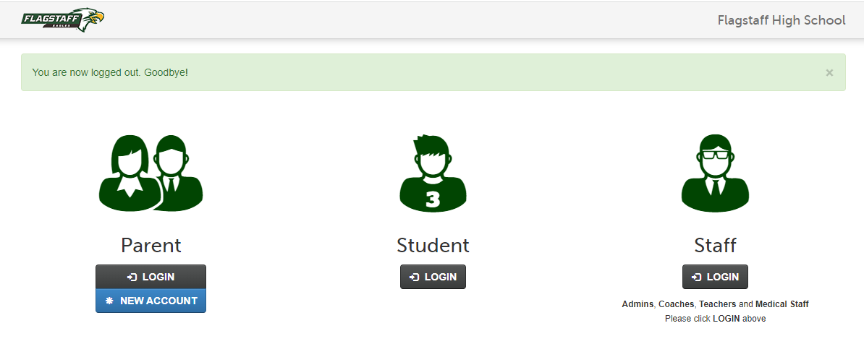
FinalForms ~ https://flagstaff-az.finalforms.com/

Slide 12
Registration ~ FinalForms

Slide 13
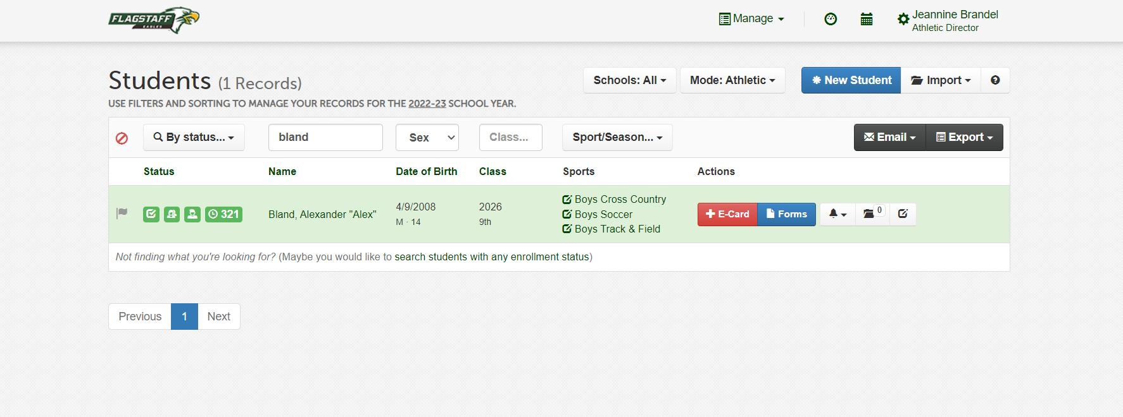
Registration ~ FinalForms

Slide 14
Registration ~ FinalForms

Slide 15
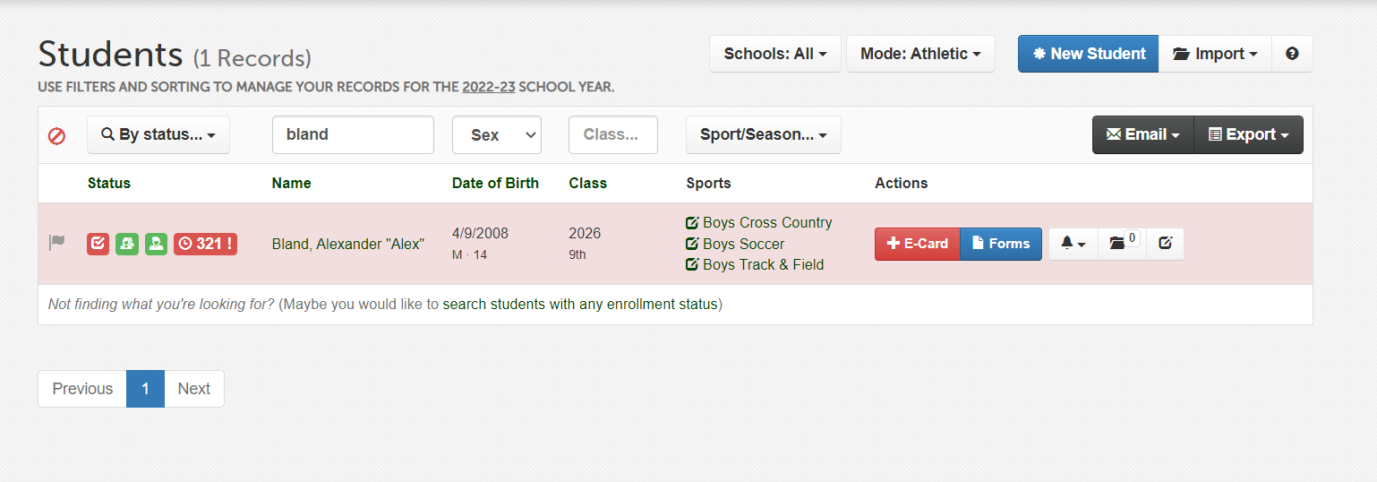
Registration ~ FinalForms

Slide 16
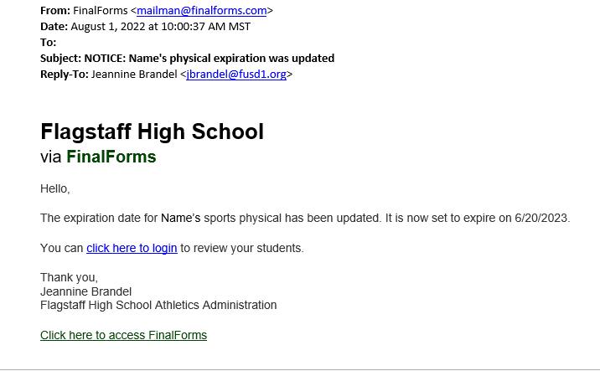
Registration ~ FinalForms

Slide 17
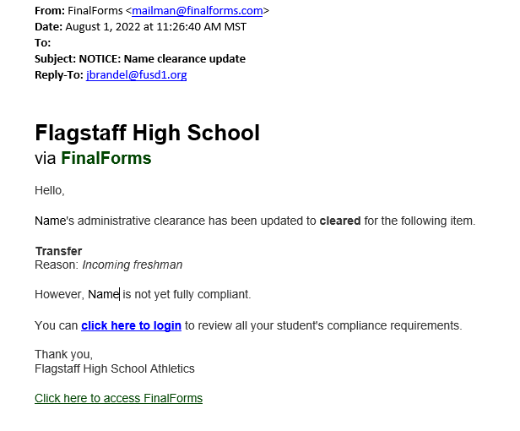
Registration ~ FinalForms

Slide 18
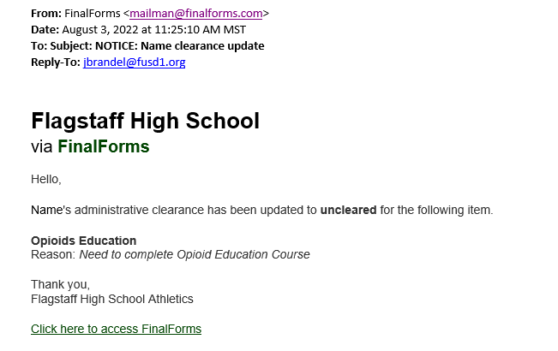
Registration ~ FinalForms

Slide 19
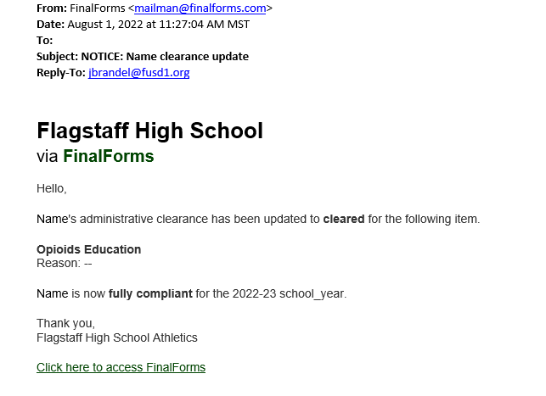
Registration ~ FinalForms

Slide 20
ATHLETIC PASSES
We will be selling Athletic Passes this year. These passes will get you into all home contests with the following exceptions:
NAU Skydome – tickets will be purchased through NAU Central Ticketing
Tournaments
Fast Times in the Cool Pines
Wade Hendershott
Pepsi Tournament
State Games
$50 for Adults and $25 for Students K-12
Also, passes will get you into Flag vs Coco Games

Slide 21
SCHEDULES
Schedules are available on the AIA website. Go to:
http://www.azpreps365.com/schools/flagstaff
Tickets for home events will be through GoFan
Online Only ~ No Cash

Slide 22
AIA PARTICIPATION FEE
$150 a year
$225 Family Cap
For non-cut sports payable upon registration
Cut Sports pay once teams are formed
Non-Refundable/Tax Credit Eligible
Helps cover the cost of programs

Slide 23
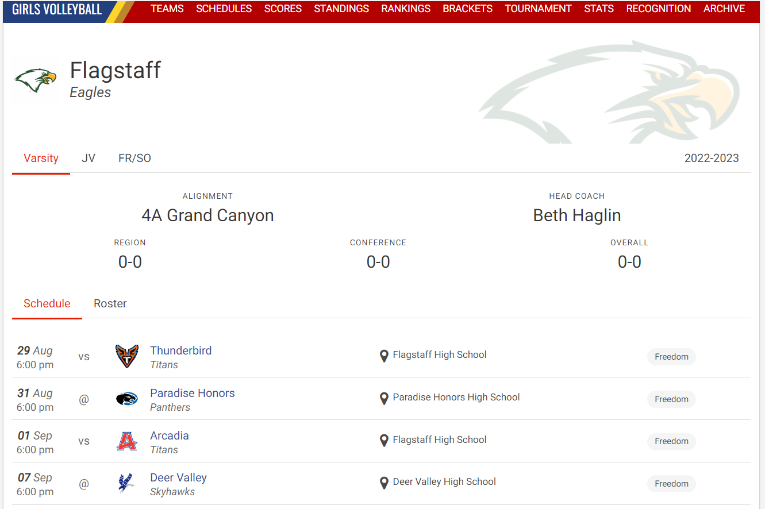
Schedules

Slide 24
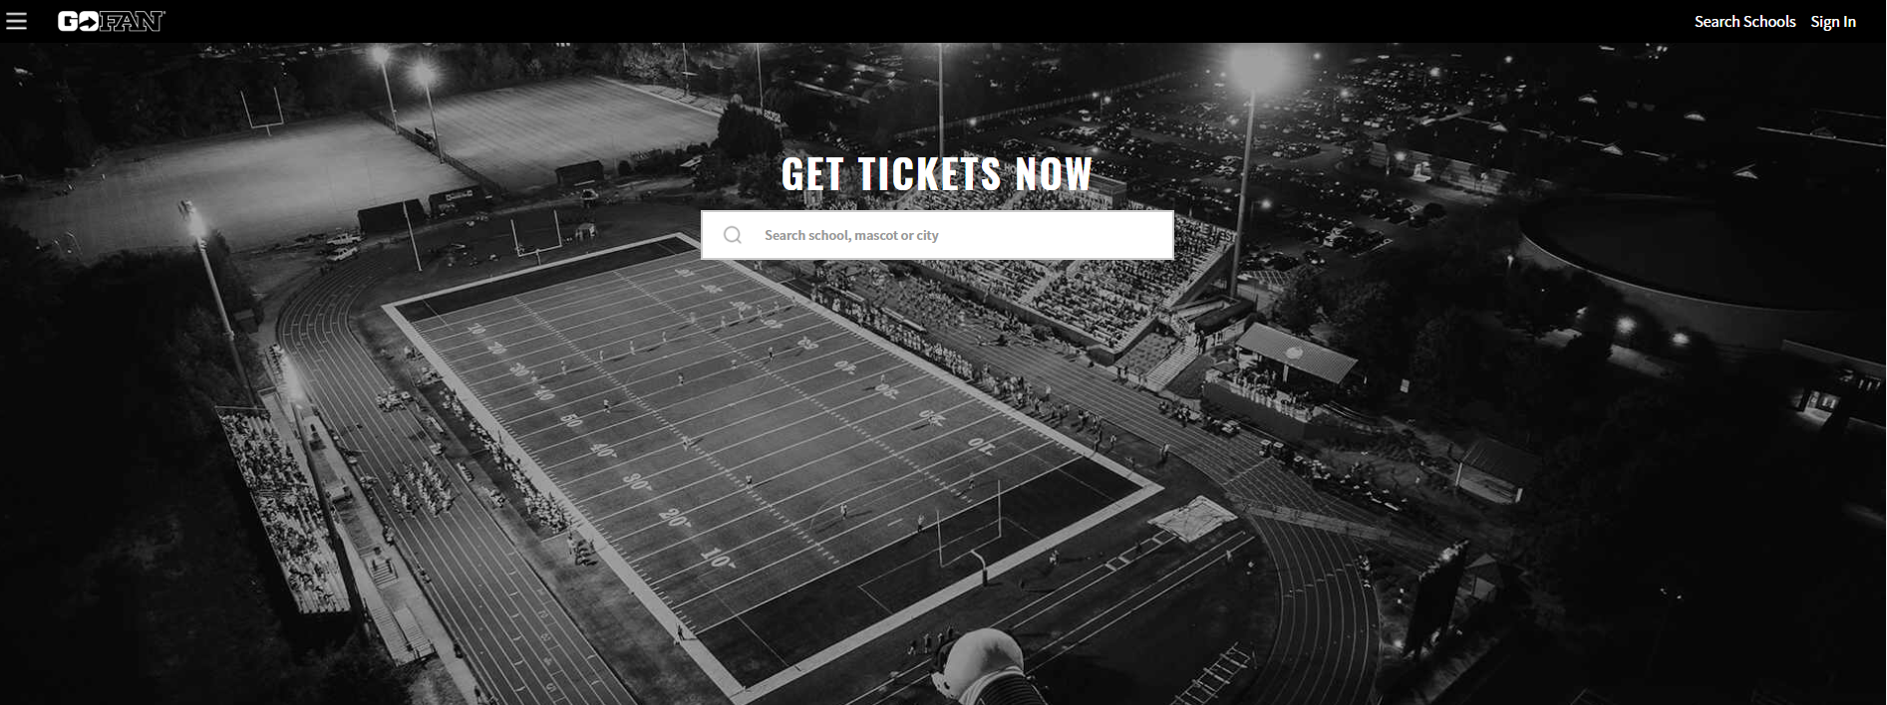
Ticketing through GoFan ~ https://gofan.co/search

Slide 25
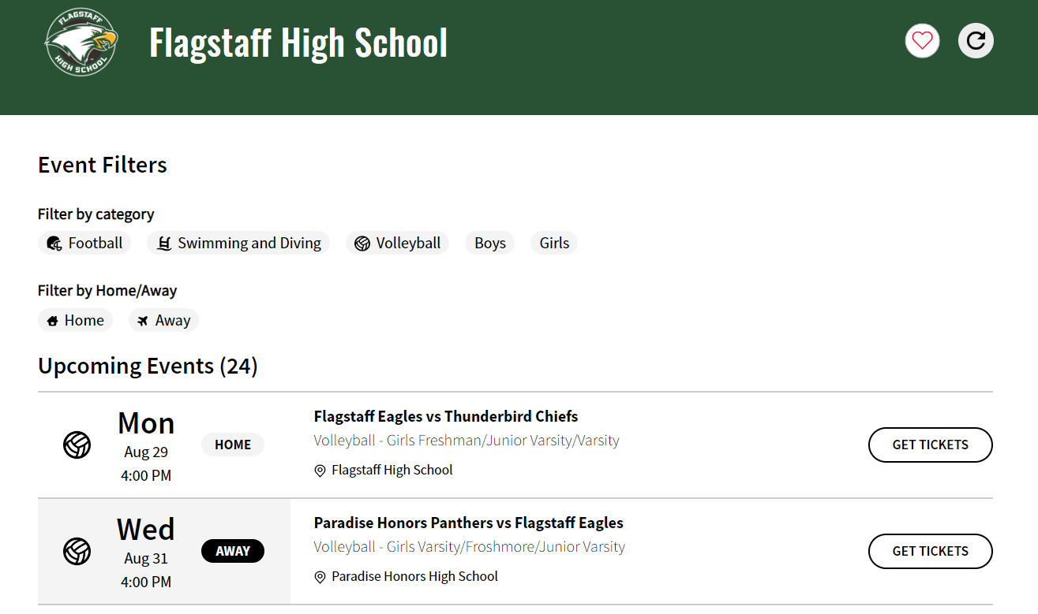
GoFan

Slide 26
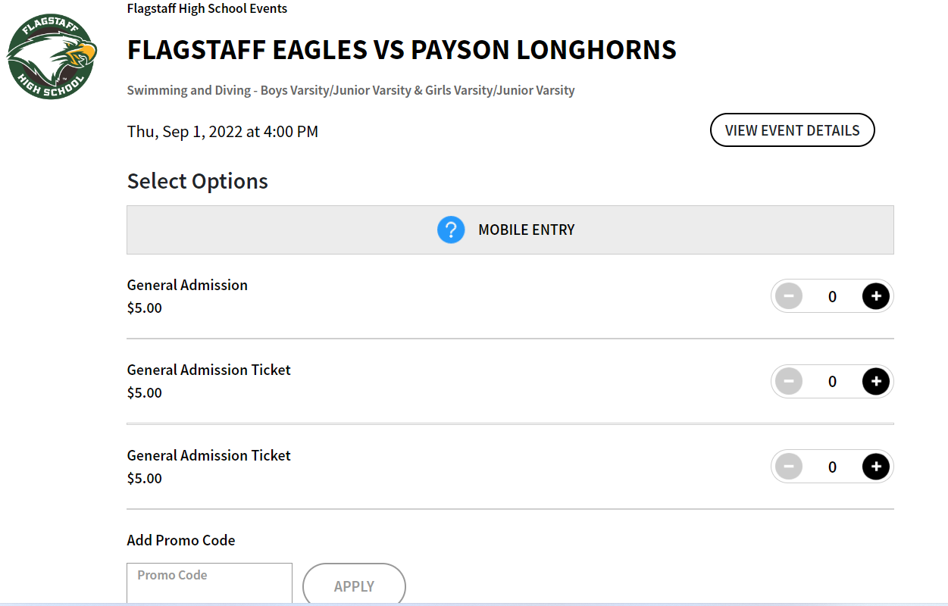
GoFan

Slide 27
EXPECTATIONS
STUDENT-Athlete
Keep up with Class Work
Grades Checked Every 3 Weeks (Schedule will be posted on our website)
Passing All Classes
1st F can remediate, subsequent F’s miss 3 weeks
School Philosophy
Attendance
Sportsmanship
Respect
Celebrations

Slide 28
EXPECTATIONS
Athletic Handbook
Available ~
FHS Website
FinalForms Website
Please review and understand the expectations to be a student-athlete at Flagstaff High School

Slide 29
COMMUNICATION
We are here to help, please contact us if you need assistance. However please remember that when contacting coaches it is important that you do it away from competition, right before and right after a competition are difficult times to give you the attention you deserve, so please allow some time to pass before approaching a coach with a frustration or concern.

Slide 30
COVID IMPACT ON SPORTS
Standard Stay Healthy Procedures for ALL Members of the Athletic Community
Stay home when sick.
Wash hands frequently for at least 20 seconds.
Use sanitizer.
Cover your mouth and face if you sneeze or cough (sneeze or cough into your elbow).
Avoid touching face with hands.
Avoid physical contact
WEAR MASKS if practical – not required
Athlete Positive:
Isolate a minimum of 5 days
Don’t hurt the team – it’s better
to miss 5 days than to bring down
the whole team.
Don’t share water bottles.
Be Smart!
Additional Information Available on the District and Athletic Website

Slide 31
COVID-19 INFORMATON
COVID-19 PROTOCOL:
More often than not, the better-prepared team wins. Don’t underestimate the competition – get the scouting report on COVID-19, Then get the facts about vaccination. Prepare and execute your game plan accordingly. #DontMissYourShot
Our ultimate goal is to ensure that all students have an opportunity to enjoy healthy participation in high school sports and performing arts.

Slide 32
Return to Play Form
Individuals who have had COVID-19 are at risk of developing severe cardiac complications that can affect participation in sport. There is limited research in this area particularly in youth athletes to standardize clinical decision making. For these reasons, it is strongly recommended that this form be completed by the patient’s primary care provider. Evaluation and management by the primary care provider allows for the patient’s past medical and cardiac history to be known.
Athletes who have tested positive to COVID will need to see a doctor and complete the return to play form.
This form is available in the registration materials under “Situational Forms”
Upon return athletes will work with our Athletic Training Staff to progress back to play.
Stage 1 ~ Light activity for 15 minutes or less at an intensity no greater than 70% of maximum heart rate (e.g. walking, jogging, stationary bike). No resistance training
Stage 2 ~ Light activity with simple movement activities (e.g. running drills) for 30 minutes or less at an intensity no greater than 80% maximum heart rate. No resistance training
Stage 3 ~ Progress to more complex training for 45 minutes or less at an intensity of no greater than 80% maximum heart rate. May add light resistance training.
Stage 4 ~ Normal training activity for 60 minutes or less at an intensity no greater than 80

Slide 33
Welcome and Have Fun
“You’re not your circumstance,
You’re not what happens to you.
You’re what you make of it!
-- Jon Stewart
Stay Safe and most importantly --
ONCE AN EAGLE, ALWAYS AN EAGLE

